Slide 1
Learning with the Center for the Study of Local Issues: Instructional Meeting
Agenda:
Welcome
Introductory script
Student Participation Confirmation Form
Student Telephone Use
Student Marking Instructions
Students: Complete the survey questionnaire, then off to the phones
Dan Nataf, PhD, Director
Center for the Study of Local Issues
Careers 132
Anne Arundel Community College
101 College Parkway
Arnold, MD 21012-1895
http:www2.aacc.edu/csli
ddnataf@aacc.edu
410.777.2733

Slide 2
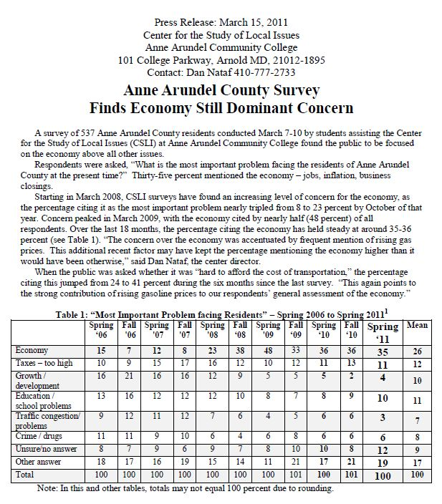
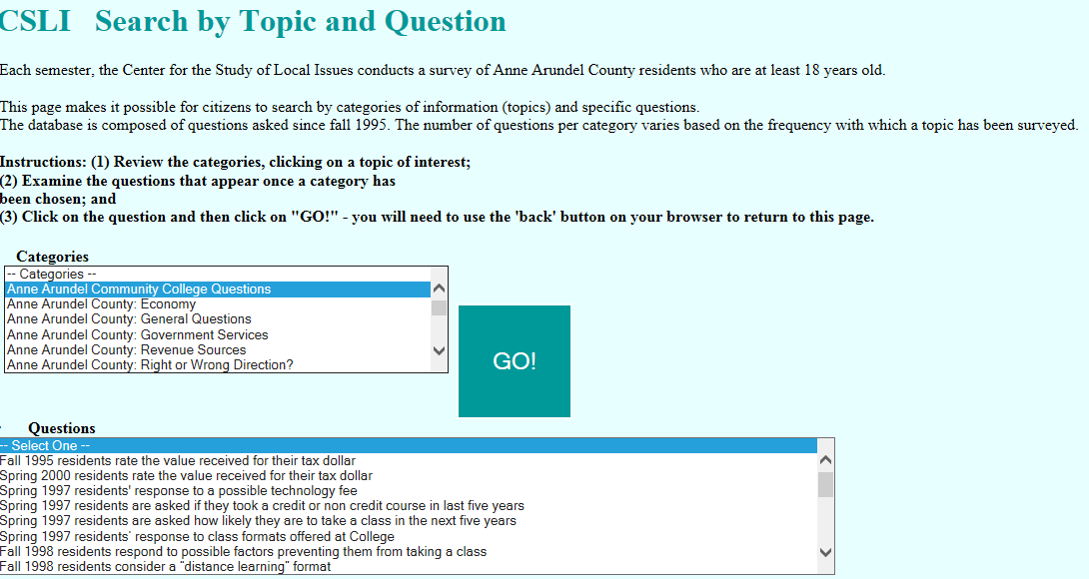
Welcome!
Center for the Study of Local Issues - A Community/College Resource
A research center at AACC since 1980
Surveys of County residents each semester
Public access to all findings back to 1995 – www2.aacc.edu/csli
Interactive database
Press releases
Public presentations

Slide 3
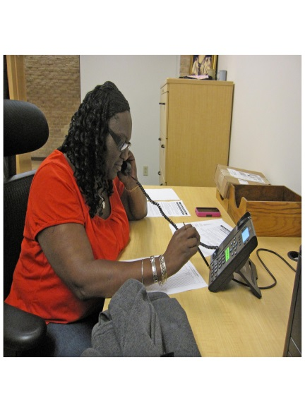
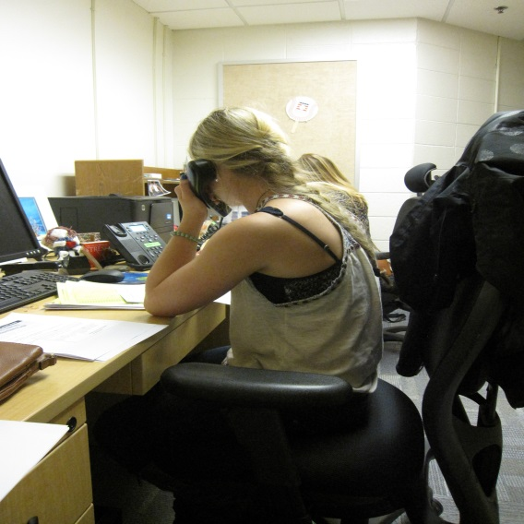
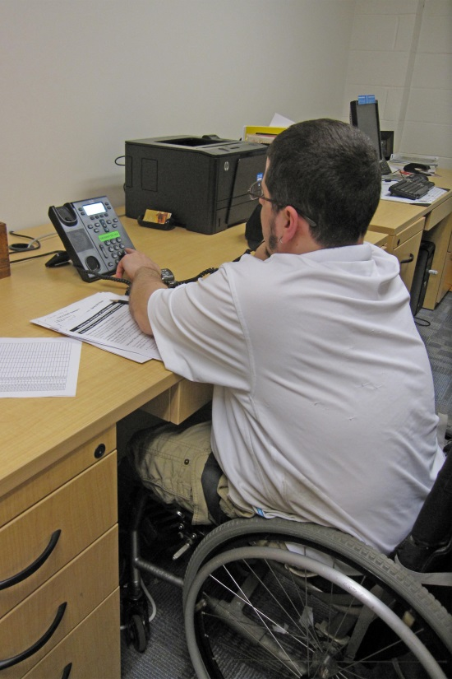
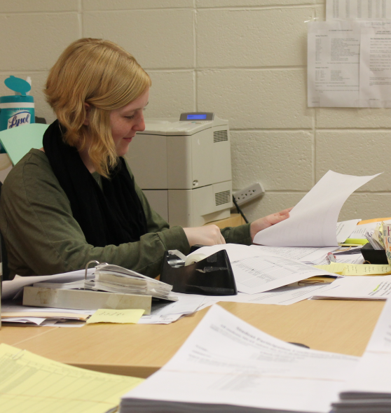
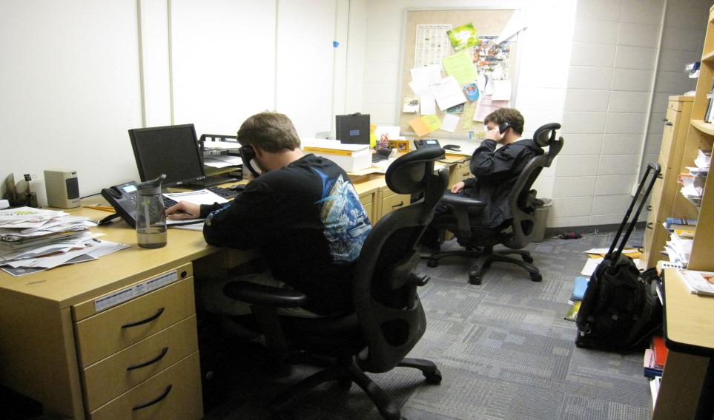
Students’ Role
Students – key to accomplishing these surveys
Telephone interviewing
Data entry

Slide 4
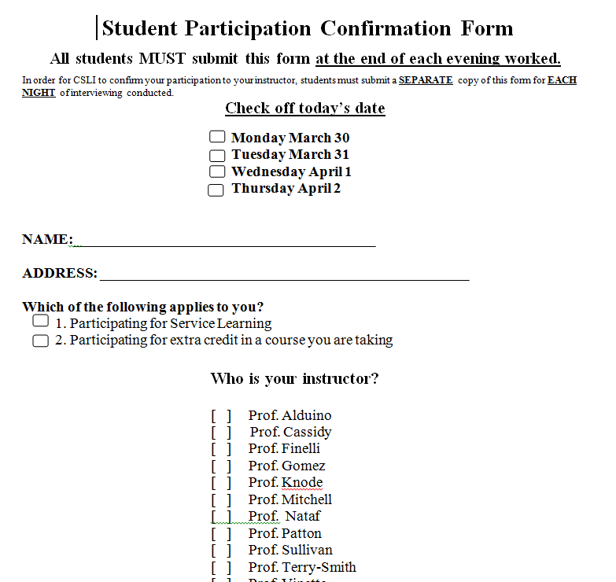
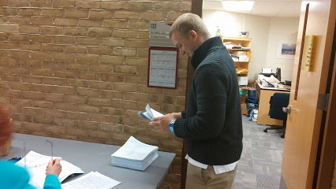
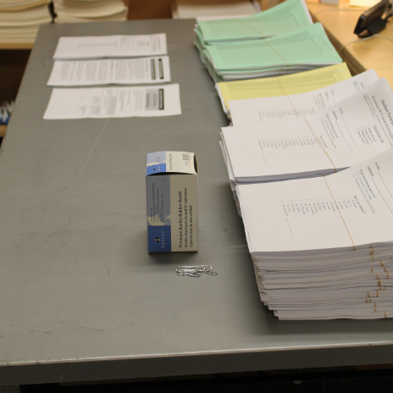
Students’ Participation
Complete the “Student Participation Confirmation Form – info to instructors
Turn it (and ALL other materials) in at the END OF THE INTERVIEWING PERIOD – Table outside Careers 132

Slide 5
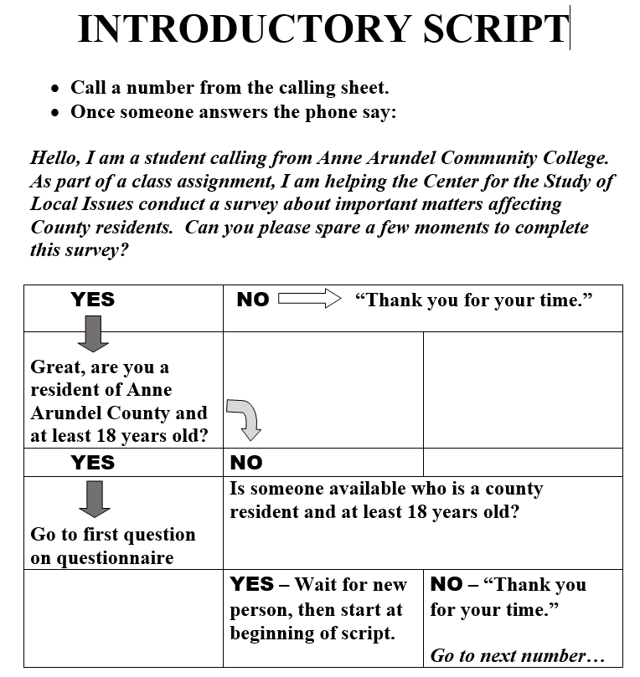
Student Instructions: Introductory Script
Main Goal: Generate Completed Surveys with qualified residents
Introductory Script: Read once someone answers phone

Slide 6
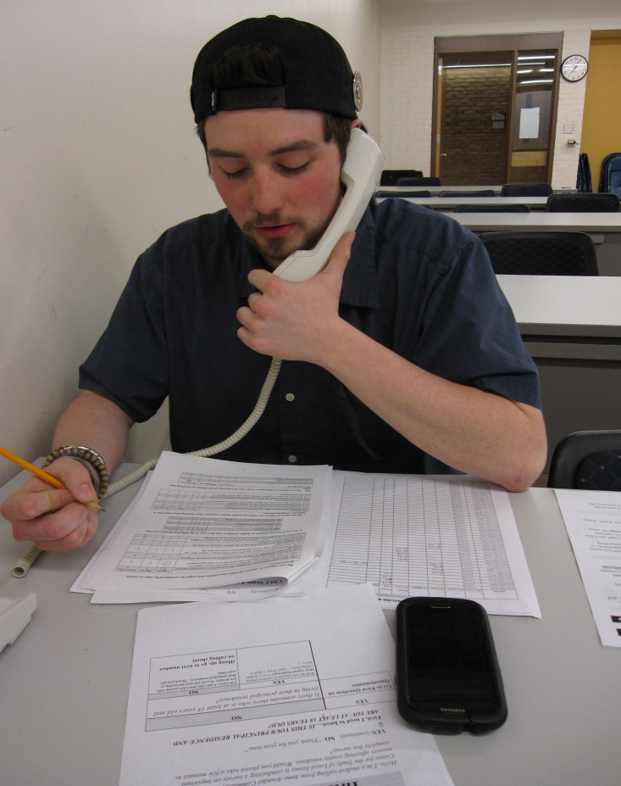
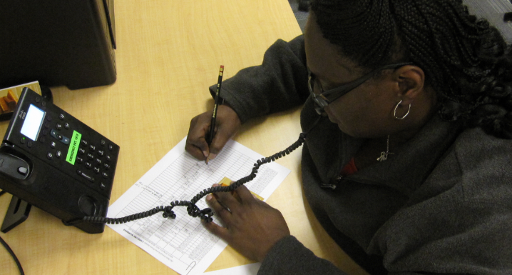
Telephone Numbers…
Monitoring: All calls are noted by AACC - number, time and duration
Use the list of telephone numbers to identify the results of the call
Results: Was it a completion, a refusal, an ineligible person, a busy/voicemail, a bad number or something else?
Accountability: PUT THE TIME AT THE END OF THE CALL IN THE CELL

Slide 7
Calling Instructions (p. 2)
Get an outside line –
DIAL “9” prior to the area code and telephone number (add “1”if needed)
Special circumstances:
Busy signal, voicemail, no answer on first try
Check off the appropriate box and try again before leaving the page; note the call back time in the "other" space provided on the calling sheet.
Wrong (Changed) Numbers, Faxes, Modems, Businesses
Make a notation in the "No Answer/Bad #" space provided and move to the next number
Can’t Speak to You Right Now –
say “Call I call you back at a specific time later tonight?” (Write call back time in “Other” space )
Respondent Says: “Can I Call You Back Later” –
say “Please call the Center for the Study of Local Issues during the day at 410-777-2733 to complete the survey.”

Slide 8
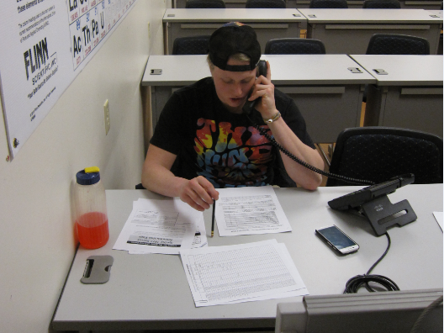
Calling Instructions p.3
Telephone/Office Manners
Avoid personal conversations with respondents or ANYONE ELSE – you are here to do work for CSLI not socialize
AACC’s academic integrity policy not to cheat – falsifying of calls and/or survey entries falls under this policy AS DOES UNNECESSARY USE OF YOUR CELL TELEPHONE
Failure to abide by these policies with result in notification to your instructor and possible disciplinary action by AACC
NO EATING – only a short break OUTSIDE the office is permitted; Only keep bottled drinks with tops left on.
FACULTY EQUIPMENT – Don’t use anything other than the telephone
Don't use the SPEAKERPHONE

Slide 9
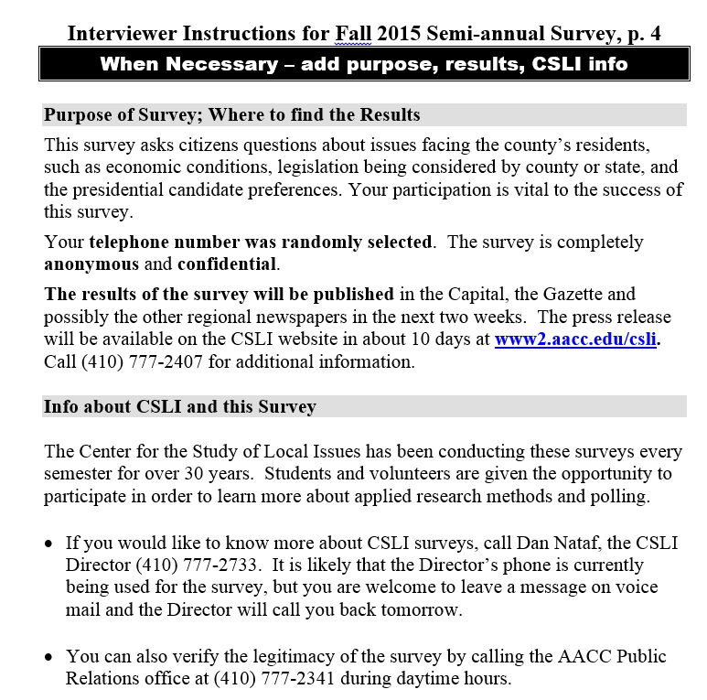
Calling Instructions p.4
If needed explain survey purpose, how telephone number was obtained, survey is anonymous, confidential
Access in Capital, Gazette, CSLI website – Info re: CSLI

Slide 10
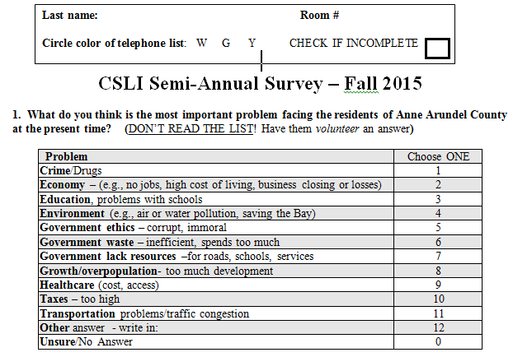
Marking Instructions p.5
Identify: Write your last name, room number at top of survey questionnaire (for completes or incomplete (check box))
Circle the color of the paper upon which your telephone numbers are printed – Use G for Green, and.
Y for yellow
W for white

Slide 11
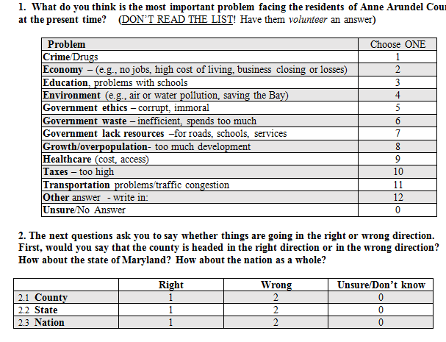
Marking Instructions p.5
Questions – CIRCLE the correct answer – make sure that the circle is clear; erase if necessary

Slide 12
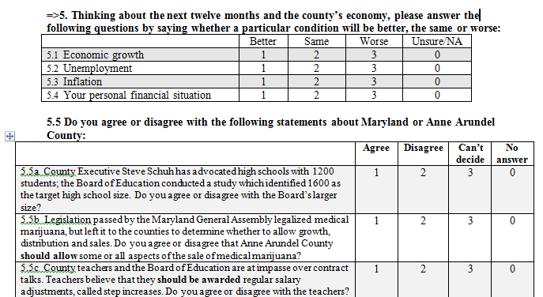
Marking Instructions p.5
Don’t know, unsure, no answer
Don’t volunteer these answer choices unless it is written into the question as an answer choice or is volunteered by the respondent. If there is a separate “unsure” or “can’t decide” then circle that number under those conditions.
Circle “unsure/no answer” if the respondent can’t decide or has no response after 10 seconds (and maybe after reading the question a second time!).

Slide 13
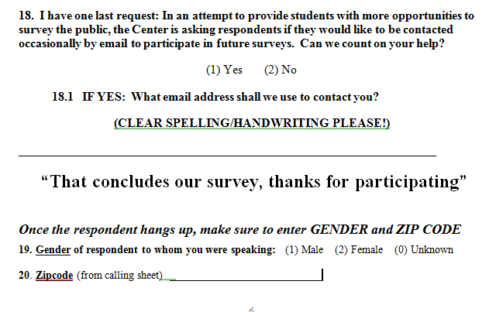
Marking Instructions
Near end of survey
Ask respondent about providing us with email address for future surveys
BE SURE TO NOTE GENDER (your decide) AND ZIPCODE (from calling sheet)

Slide 14
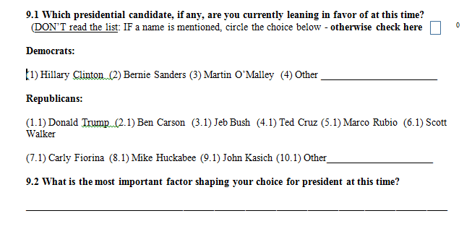
Marking Instructions
Open-ended questions – these have no preset answer choices (or there is a list of such choices, but instructions say “DON’T READ THE LIST!”)
Write a short answer – enough words that the answer is clear enough to code afterwards
Jim Webb
Lindsay Graham
Examples: “Best experience” or “agree with his policies” or “good personality/temperament” or “agree with –specific policy (taxes, defense, free college )

Slide 15
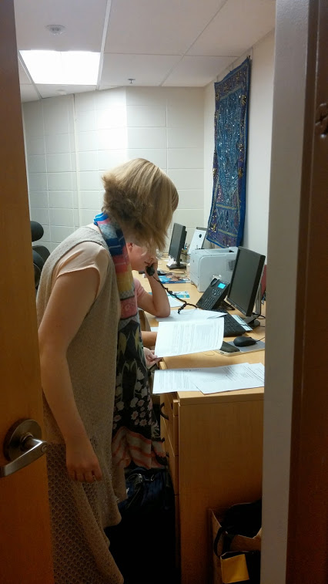
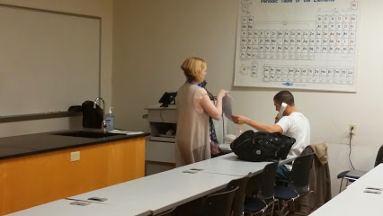
Finally…
A student intern or supervisor will come in periodically to check for completed surveys – put them to the side so that they are visible
Don’t forget to bring ALL your materials (including any uncollected surveys) to the table near the CSLI door at the end of the evening.

Slide 16
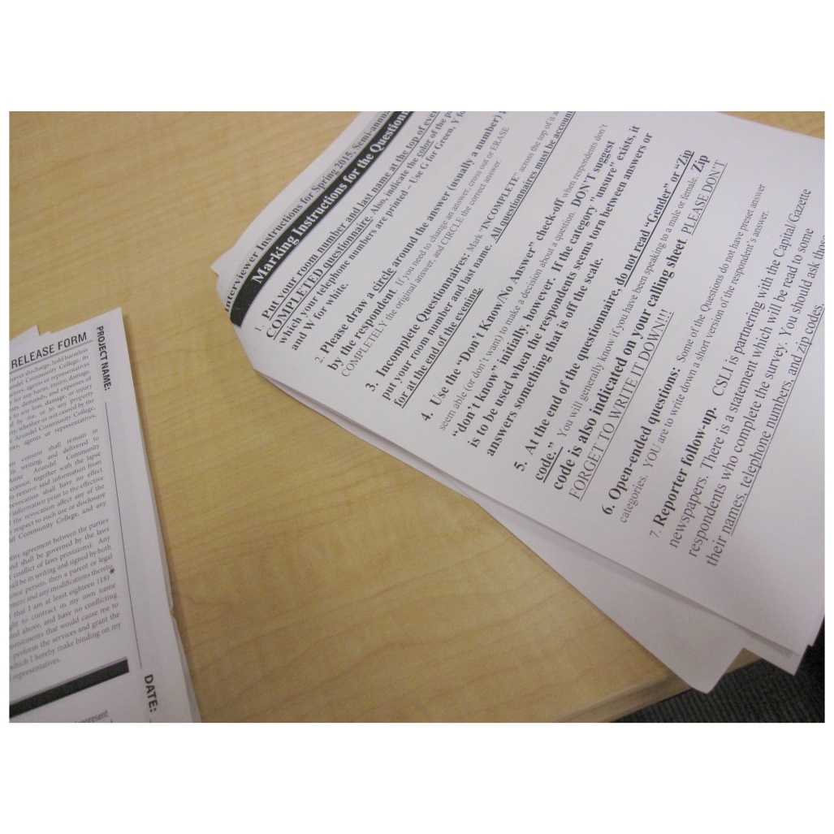

Slide 17
